Slide 1
Latitudinal distribution of tree species in the Eastern United States

Slide 2
Preparing the Forest Inventory Data for analysis
1. Libraries
To prepare the data for analysis,
-First, 4 libraries were installed and called
library(readr) library(dplyr) library(sf) library(ggplot2)

Slide 3
Preparing the Forest Inventory Data for analysis
2. Join required data frame
-Second,the common name was appended to the data frame.
REF_SPECIES <- read_csv("G:/Rtestproject/data/REF_SPECIES.csv") head(REF_SPECIES) commonname<-REF_SPECIES%>% select(SPCD,COMMON_NAME,GENUS,SPECIES) tree_raw_common<-left_join(tree_raw_data_with_env_cleaned,commonname, by=c("spcd"="SPCD"),relationship = "many-to-many")

Slide 4
Preparing the Forest Inventory Data for analysis
3. View data frame structure
-Third,the structure of the data frame was studied.
str(tree_raw_common)

Slide 5
Analyzing NA values in the data frame.
NA values: 683617 rows were removed.
rows_with_na <- tree_raw_common[apply(is.na(tree_raw_common), 1, any), ] unique(rows_with_na$statename) ##states with na entries unique(rows_with_na$COMMON_NAME) ##species with na entries nrow(rows_with_na) ###683617 rows nona_tree_raw<-na.omit(tree_raw_common) nrow(nona_tree_raw) ###683617 rows remove summary(nona_tree_raw)

Slide 6
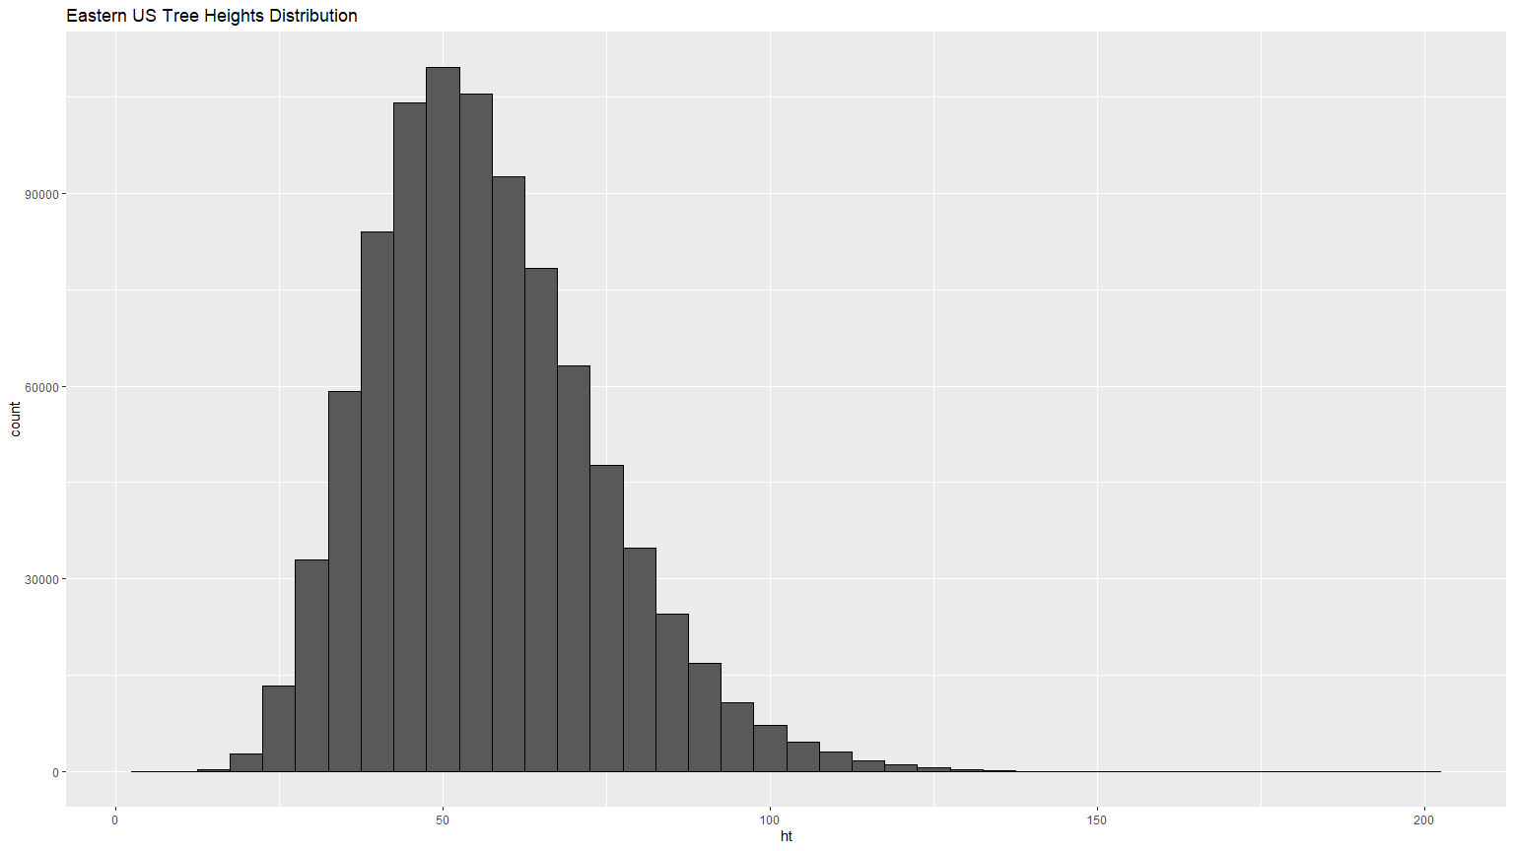
Explanatory Data Analysis of Forest Inventory Dataframe
1.Eastern US Tree Heights Distribution
plot_tree_height<-ggplot(nona_tree_raw, aes(x = ht)) + geom_histogram(binwidth = 5,color = "black") + labs(title = "Eastern US Tree Heights Distribution")

Slide 7
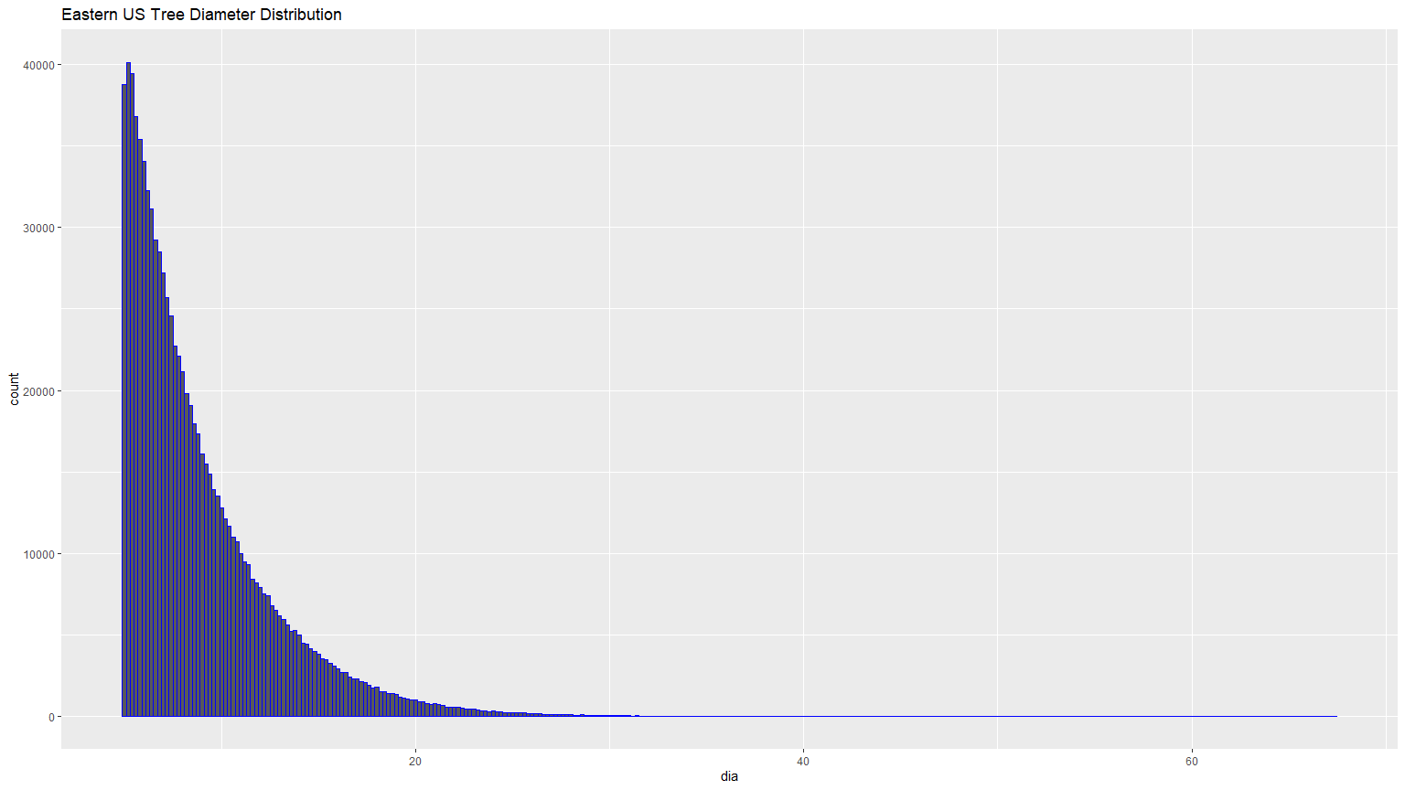
Explanatory Data Analysis of Forest Inventory Dataframe
2.Eastern US Tree Diameter Distribution
plot_tree_dia<-ggplot(nona_tree_raw,aes(x=dia))+ geom_histogram(binwidth = 0.2,color = "blue")+ labs(title = "Eastern US Tree Diameter Distribution")

Slide 8
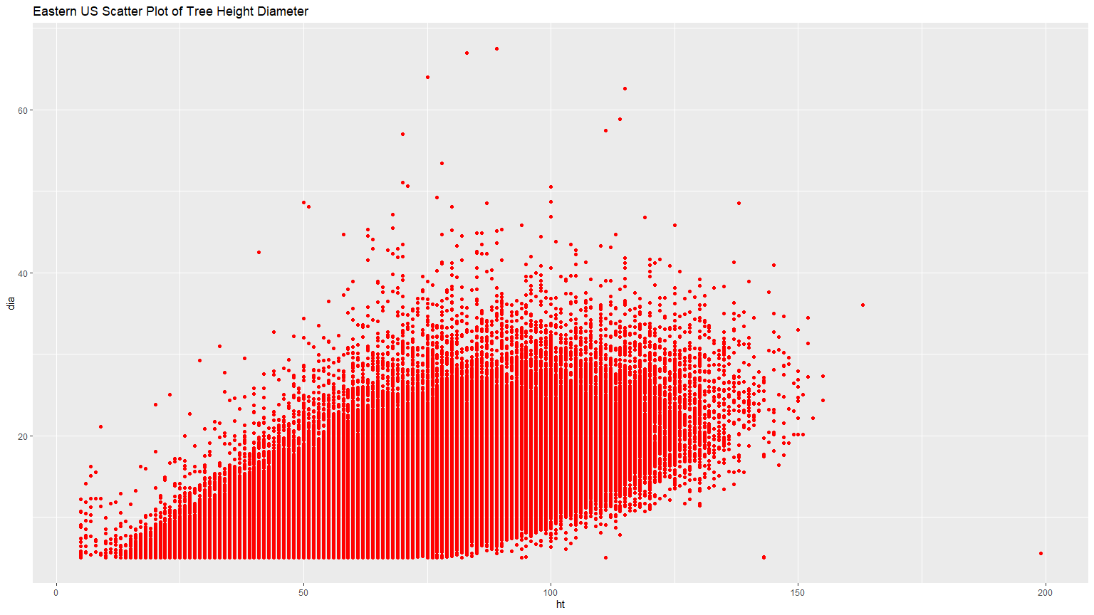
Explanatory Data Analysis of Forest Inventory Dataframe
3.Eastern US Scatter Plot of Tree Height vs Diameter
scatter_plot_ht_dia<-ggplot(nona_tree_raw, aes(x = ht, y = dia)) + geom_point(color="red") + labs(title = "Eastern US Scatter Plot of Tree Height Diameter")

Slide 9
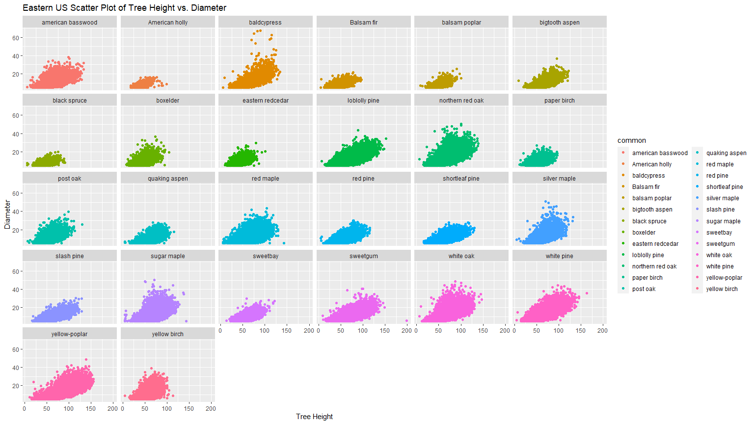
Explanatory Data Analysis of Forest Inventory Dataframe
4.Eastern US Scatter Plot of Tree Height vs Diameter for each species
scatter_plot_ht_dia_facetwrap <- ggplot(nona_tree_raw, aes(x = ht, y = dia, color = common)) + geom_point() + facet_wrap(~common) + labs(title = "Eastern US Scatter Plot of Tree Height vs. Diameter", x = "Tree Height", y = "Diameter")

Slide 10
Explanatory Data Analysis of Forest Inventory Dataframe
5.NA values distribution grouped by state
na_distribution_by_state <- tree_raw_common %>% group_by(statename) %>% select(spcd,common,dia,ht)%>% summarize(across(everything(), ~ sum(is.na(.))))

Slide 11
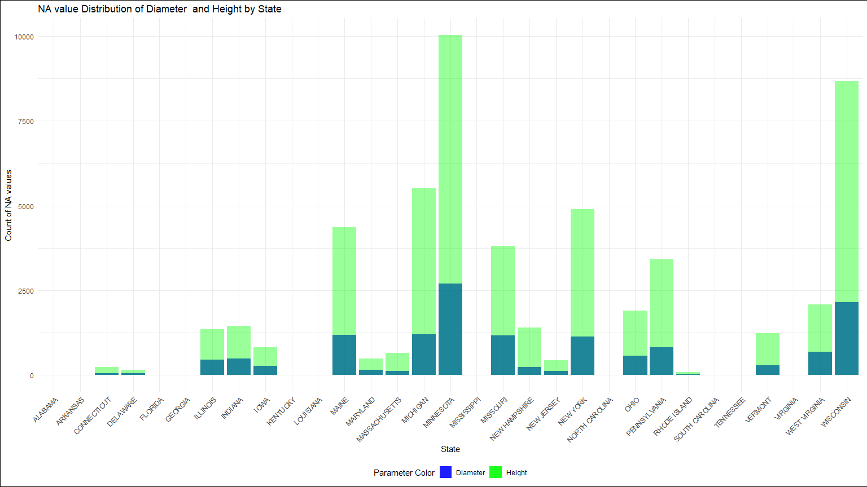
Explanatory Data Analysis of Forest Inventory Dataframe
5.NA values distribution grouped by state
plot_na_distribution_by_state <- ggplot(na_distribution_by_state, aes(x = statename)) + geom_bar(aes(y = dia, fill = "Diameter"), stat = "identity", alpha = 0.8) + geom_bar(aes(y = ht, fill = "Height"), stat = "identity", alpha = 0.4) + labs(title = "NA value Distribution of Diameter and Height by State", x = "State", y = "Count of NA values") + scale_fill_manual(values = c("Diameter" = "blue", "Height" = "green"), name = "Parameter Color") + theme_minimal() + theme(legend.position = "bottom", plot.background = element_rect(fill = "white"), axis.text.x = element_text(angle = 45, hjust = 1))

Slide 12
Explanatory Data Analysis of Forest Inventory Dataframe
6.NA values distribution grouped by species
na_distribution_by_species <- tree_raw_common %>% group_by(common) %>% select(spcd,dia,ht)%>% summarize(across(everything(), ~ sum(is.na(.))))

Slide 13
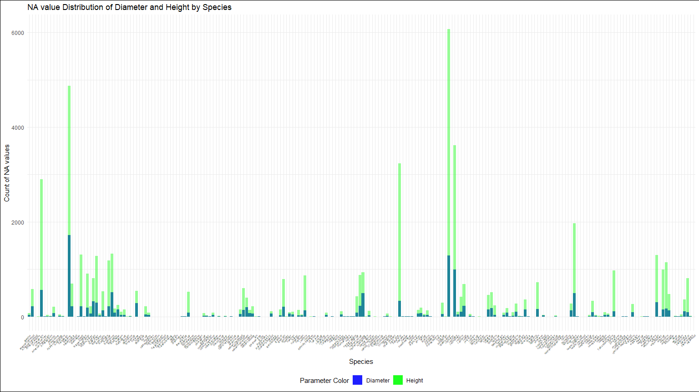
Explanatory Data Analysis of Forest Inventory Dataframe
6.NA values distribution grouped by species
plot_na_distribution_by_species <- ggplot(na_distribution_by_species, aes(x = common)) + geom_bar(aes(y = dia, fill = "Diameter"), stat = "identity", alpha = 0.8) + geom_bar(aes(y = ht, fill = "Height"), stat = "identity", alpha = 0.4) + labs(title = "NA value Distribution of Diameter and Height by Species", x = "Species", y = "Count of NA values") + scale_fill_manual(values = c("Diameter" = "blue", "Height" = "green"), name = "Parameter Color") + theme_minimal() + theme(legend.position = "bottom", plot.background = element_rect(fill = "white"), axis.text.x = element_text(angle = 45, hjust = 1, size = 4))

Slide 14
Explanatory Data Analysis of Forest Inventory Dataframe
7.Top 50 most abundant tree species in the Eastern US
abundance_species <- tree_raw_common %>% group_by(common) %>% summarise(abundance = n()) %>% arrange(desc(abundance)) %>% head(50)

Slide 15
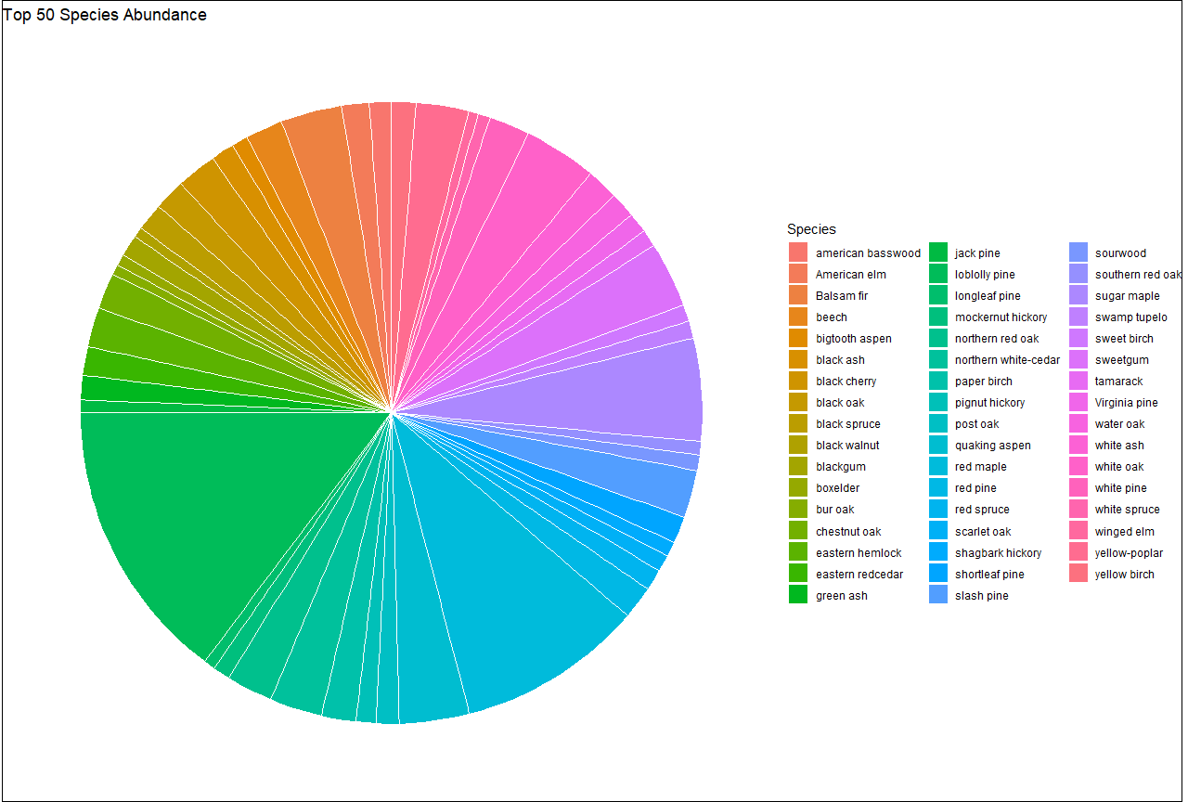
Explanatory Data Analysis of Forest Inventory Dataframe
7.Top 50 most abundant tree species in the Eastern US
pie_plot <- ggplot(abundance_species, aes(x = "", y = abundance, fill = common)) + geom_bar(stat = "identity", width = 1, color = "white") + coord_polar("y") + labs(title = "Top 50 Species Abundance", fill = "Species") + theme_void() + theme(plot.background = element_rect(fill = "white")) print(pie_plot) ggsave("Top 50 Abundant Species_piechart.png", pie_plot, width = 12, height = 6)

Slide 16
Explanatory Data Analysis of Forest Inventory Dataframe
8.Statewide abundance and richness of top 50 most abundant tree species
abundance_joined<-left_join(abundance_species,tree_raw_common,by=c("common"="common")) abundance_joined abundance_state<-abundance_joined%>% select(common,abundance,statename)%>% group_by(statename)

Slide 17
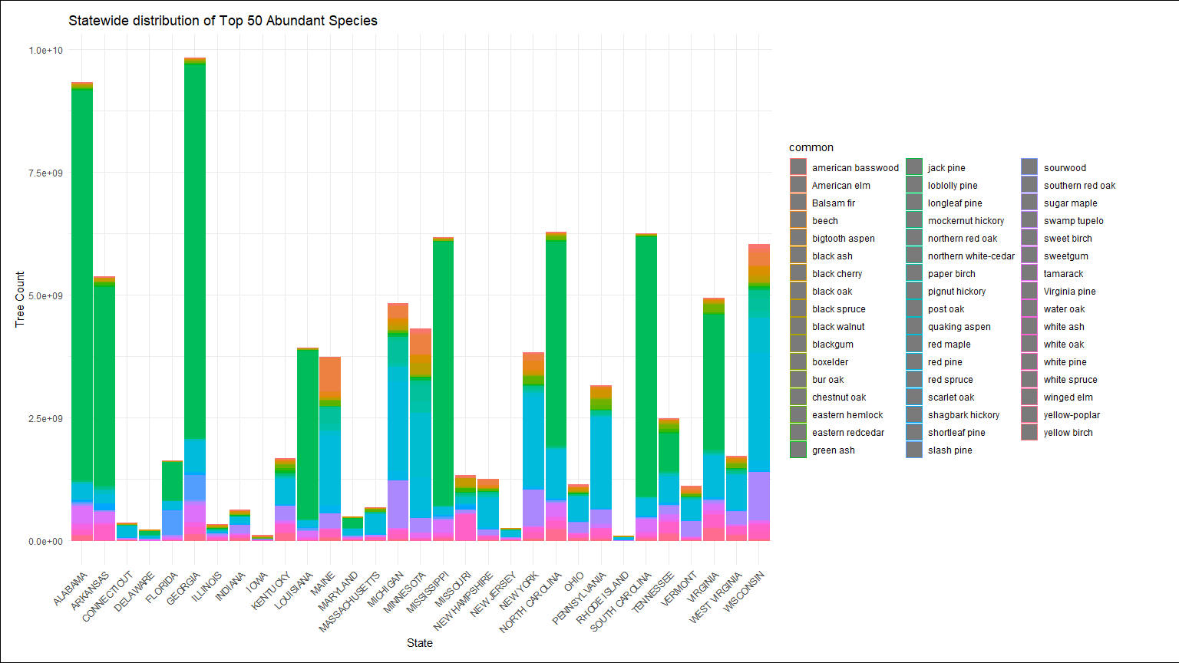
Explanatory Data Analysis of Forest Inventory Dataframe
8.Statewide abundance and richness of top 50 most abundant tree species
plot_top50 <- ggplot(abundance_state, aes(x = statename, color = common)) + geom_bar(aes(y = abundance), stat = "identity", alpha = 0.8) + labs(title = "Statewide distribution of Top 50 Abundant Species", x = "State", y = "Tree Count") + theme_minimal() + theme(legend.position = "right", legend.box = "vertical", axis.text.x = element_text(angle = 45, hjust = 1, vjust = 1), plot.background = element_rect(fill = "white"), plot.margin = margin(0.5, 2, 0.5, 0.5, "cm"))

Slide 18
Calculating tree species richness at grid level
1. Creating an sf object
fia <-read_csv("G:/Rtestproject/r-intro/tree data/tree_raw_data_with_env_cleaned.csv") fia_df <- fia %>% select(X, TREEcn, plt_cn, invyr, statecd, spcd, dia, ht, lat, long, common) fia_sf <- st_as_sf(fia_df, coords = c("long", "lat"), crs = 4326) fia_sf_albers <- st_transform(fia_sf, crs = "ESRI:102008") extent <- st_bbox(fia_sf_albers)

Slide 19
Calculating tree species richness at grid level
2. Creating a 20*20 grid
grid <- st_make_grid(st_as_sfc(extent), crs = "ESRI:102008", cellsize = c(20000, 20000), square = TRUE) grid_sf <- st_sf(id = 1:length(grid), geometry = grid)

Slide 20
Calculating tree species richness at grid level
3. Joining and overlaying the grid and the data frame
overlaps <- st_join(fia_sf_albers, grid_sf) centroids_albers <- st_centroid(grid_sf$geometry)

Slide 21
Calculating tree species richness at grid level
4. Extracting the unique overlapping grids into a data frame
id1 <- unique(overlaps$id) centroids_albers <- st_centroid(grid_sf[grid_sf$id %in% id1,]$geometry) centroids_wgs84 <- st_transform(centroids_albers, crs = 4326) centroids_wgs84_coords <- st_coordinates(centroids_wgs84) gridid <- grid_sf[grid_sf$id %in% id1,]$id centroid_df <- data.frame( GRIDID = id1, centroid_long = centroids_wgs84_coords[,"X"], centroid_lat = centroids_wgs84_coords[,"Y"] )

Slide 22
Calculating tree species richness at grid level
5. Merging the unique grids with the Forest Inventory data frame
fia_grid <- merge(overlaps, centroid_df, by.x = "id", by.y = "GRIDID", all.x = TRUE) fia_grid_df <- as.data.frame(fia_grid) fia_grid_df

Slide 23
Calculating tree species richness at grid level
6. Calculating species richness per grid
sp_rich<- fia_grid_df %>% ##calculating species richness select(id, common,centroid_long, centroid_lat,spcd) %>% group_by(id)%>% summarise(uniquetreecount_id = n_distinct(spcd)) final_sp_rich<-left_join(fia_grid_df,sp_rich,by=c("id"="id")) final_sp_rich ##joining species richness with the data frame

Slide 24
Calculating tree species richness at grid level
7. Checking for NA values and cleaning up the data frame
sum(is.na(final_sp_rich)) sel_col_sp_rich<-final_sp_rich%>% select(id, common,spcd,centroid_long, centroid_lat,uniquetreecount_id) sel_col_sp_rich sum(is.na(sel_col_sp_rich)) ##0 cleaned_sp_rich<-na.omit(sel_col_sp_rich) head(cleaned_sp_rich)

Slide 25
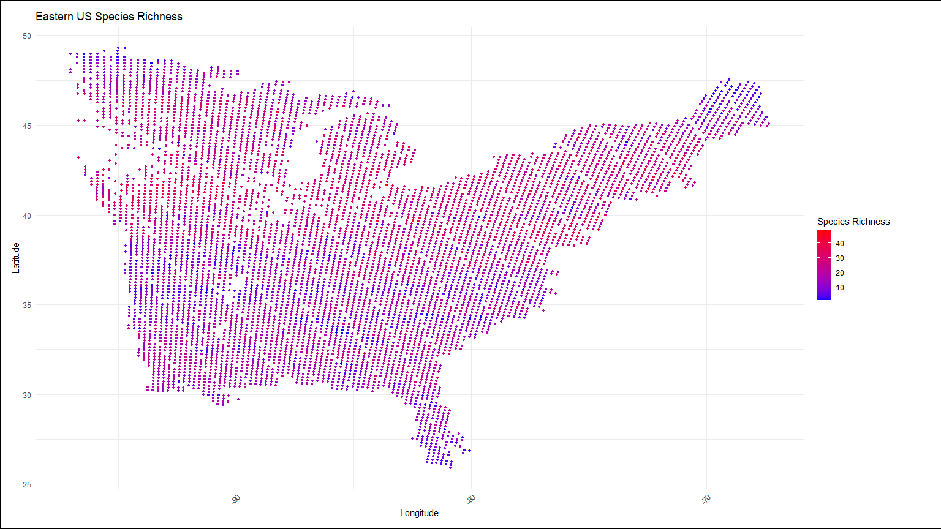
Displaying tree species rich on the Eastern US map at grid level
plot2<-ggplot(cleaned_sp_rich, aes(x = centroid_long, y = centroid_lat, color = uniquetreecount_id)) + geom_point(size = 1) + scale_color_gradient(low = "blue", high = "red", name = "Species Richness") + labs(title = "Eastern US Species Richness", x = "Longitude", y = "Latitude") + theme_minimal()+ theme(legend.position = "right", legend.box = "vertical", axis.text.x = element_text(angle = 45, hjust = 1, vjust = 1), plot.background = element_rect(fill = "white"), plot.margin = margin(0.5, 2, 0.5, 0.5, "cm"))

Slide 26
Moving average and bootstrapping
1. Creating lat band Sequence by 0.5 to create bootstrapping samples
-Creating the Latband sequence by 0.5 computes species richness as a moving average.
myseq <- seq(from = 25, to = 50, by = 0.5) bootstrap <- data.frame(matrix(nrow = length(myseq), ncol = 1001)) for (i in 1:length(myseq)) { lat_min <- myseq[i] - 0.5 lat_max <- myseq[i] + 0.5 cleaned_sp_rich_subset <-cleaned_sp_rich%>% filter(centroid_lat > lat_min & centroid_lat <= lat_max) bootstrap[i, 1] <- myseq[i]

Slide 27
Moving average and bootstrapping
2. Bootstrap random sampling and 1000 times iterating loop
-Creating subsets of 200 random samples for each lat band per iteration.
-Computing species richness aggregated at latitude level.
for (iteration in 2:1001) { sample_200 <- sample(1:nrow(cleaned_sp_rich_subset), size = 200, replace = TRUE) bootstrap_sample <- cleaned_sp_rich_subset[sample_200, ] bootstrap_sr <- length(unique(bootstrap_sample$common)) bootstrap[i, iteration] <- bootstrap_sr } } print(bootstrap) head(bootstrap)

Slide 28
Moving average and bootstrapping
3. Species Richness Mean and Standard deviations for each latband.
myseq <- seq(from = 25, to = 50, by = 0.5) Result1 <- data.frame(LatBands = numeric(length(myseq)), Mean = numeric(length(myseq)), std = numeric(length(myseq))) for (i in seq_along(myseq)) { row_data <- bootstrap[i,] means <- rowMeans(row_data, na.rm = TRUE) stds <- sd(row_data, na.rm = TRUE) Result1[i, c("LatBands", "Mean", "std")] <- c(myseq[i], means, stds) } Result1

Slide 29
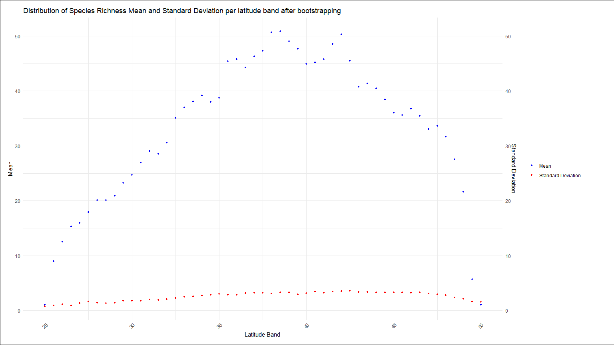
Plotting result
Latitudinal distribution of Species richness in the Eastern US
boot_plot2<- ggplot(Result1, aes(x = LatBands)) + geom_point(aes(y = Mean, color = "Mean"), size = 1, alpha = 1) + geom_point(aes(y = std, color = "Standard Deviation"), size = 1, alpha = 1) + labs(title = "Distribution of Species Richness Mean and Standard Deviation per latitude band after bootstrapping", x = "Latitude Band", y = "Mean") + theme_minimal() + theme(legend.position = "right", legend.box = "vertical", axis.text.x = element_text(angle = 45, hjust = 1, vjust = 1), plot.background = element_rect(fill = "white"), plot.margin = margin(0.5, 2, 0.5, 0.5, "cm")) + scale_color_manual(values = c("Mean" = "blue", "Standard Deviation" = "red")) + guides(color = guide_legend(title = NULL), linetype = guide_legend(title = NULL))+ scale_y_continuous( sec.axis = sec_axis(~., name = "Standard Deviation", labels = scales::number_format(scale = 1)) )

Slide 30
Question?

